Slide 1
Data Analytics
Third Year of Information Technology (2019 Course)

Slide 2
Syllabus
Unit I INTRODUCTION: DATA SCIENCE AND BIG DATA
Unit II MATHEMATICAL FOUNDATION OF BIG DATA
Unit III BIG DATA PROCESSING
Unit IV BIG DATA ANALYTICS
Unit V Big Data Visualization
Unit VI Advanced Analytics-Technology and Tools

Slide 3
BUZZ WORDS

Slide 4
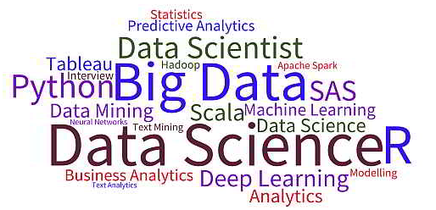
Word Cloud of BUZZ words

Slide 5
Introduction
Modern technologies such as artificial intelligence, machine learning, big data, data science, deep learning and more.
While they are all closely interconnected, each has a distinct purpose and functionality.

Slide 6
Data Science
It is the processing and analysis of data that you generate for various insights that will serve a myriad of business purposes.
For instance, when you have logged in on Amazon and browsing through a few products or categories, you are generating data.
This data will be used by a data scientist at the backend to understand your behaviour and push you retargeted advertisements and deals to get you purchase what you browsed.
Data science involves the processes of Data extraction, Data Cleansing, Analysis, Visualization and actionable Insights generation

Slide 7
Data Analyst
If data science is a house that consists of all the tools and resources, data analytics would be a specific room. It is more specific in terms of functionality and application.
Instead of just looking for connections like we do in data science, a data analyst has a specific aim and goal. Data analytics is often used by companies to search for trends in their growth.
A data analyst is usually the person who can do basic descriptive statistics, visualize data, and communicate data points for conclusions.
They must have a basic understanding of statistics, a perfect sense of databases, the ability to create new views, and the perception to visualize the data.
Data analytics can be referred to as the necessary level of data science.

Slide 8
Machine Learning
For simple comprehension, understand that machine learning is part of data science. It draws aspects from statistics and algorithms to work on the data generated and extracted from multiple resources.
What happens most often is data gets generated in massive volumes and it becomes totally tedious for a data scientist to work on it. That is when machine learning comes into action.
Machine learning is the ability given to a system to learn and process data sets autonomously without human intervention.
This is achieved through complex algorithms and techniques like regression, supervised clustering, naïve Bayes and more.
A good example of machine learning implementation is Facebook. Facebook’s machine learning algorithms gather behavioral information for every user on the social platform. Based on one’s past behavior, the algorithm predicts interests and recommends articles and notifications on the news feed. Similarly, when Amazon recommends products, or when Netflix recommends movies based on past behaviors, machine learning is at work.

Slide 9
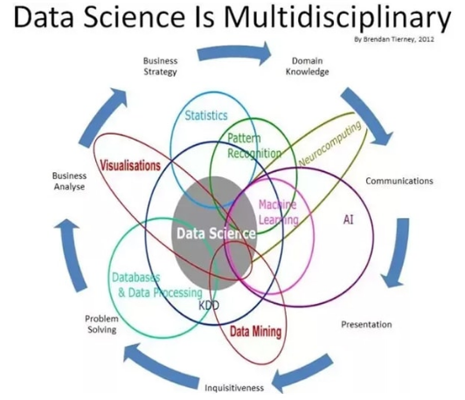

Slide 10
Data Analytics
UNIT 1
Introduction and Life cycle

Slide 11
Syllabus – Unit 1
Introduction to Data science and Big Data, Defining Data science and Big Data, Big Data examples,
Data Explosion: Data Volume, Data Variety, Data Velocity and Veracity. Big data infrastructure and
challenges, Big Data Processing Architectures: Data Warehouse, Re-Engineering the Data Warehouse,
shared everything and shared nothing architecture, Big data learning approaches.
Data Science – The Big Picture: Relation between AI, Statistical Learning, Machine Learning , Data Mining and Big Data Analytics

Slide 12
Introduction
Data is created constantly, and at an ever-increasing rate.
Mobile phones, social media, imaging technologies to determine a medical diagnosis-all these and more create new data, and that must be stored somewhere for some purpose.
Devices and sensors automatically generate diagnostic information that needs to be stored and processed in real time.
Merely keeping up with this huge influx of data is difficult, but substantially more challenging is analyzing vast amounts of it, especially when it does not conform to traditional notions of data structure, to identify meaningful patterns and extract useful information.
These challenges of the data deluge present the opportunity to transform business, government, science, and everyday life.

Slide 13
Big Data Overview
Three attributes stand out as defining Big Data characteristics:
Huge volume of data: Rather than thousands or millions of rows, Big Data can be billions of rows and millions of columns.
Complexity of data types and structures: Big Data reflects the variety of new data sources, formats, and structures, including digital traces being left on the web and other digital repositories for subsequent analysis.
Speed of new data creation and growth: Big Data can describe high velocity data, with rapid data ingestion and near real time analysis.

Slide 14
Big Data Overview
Big data applications
Credit card fraud detection
Mobile network analyses pattern of usage
Social networking analysis
Online shopping prediction

Slide 15
Big Data Overview
Although the volume of Big Data tends to attract the most attention, generally the variety and velocity of the data provide a more apt definition of Big Data. (Big Data is sometimes described as having 3 Vs: volume, variety, and velocity.)
Due to its size or structure, Big Data cannot be efficiently analyzed using only traditional databases or methods.
Big Data problems require new tools and technologies to store, manage, and realize the business benefit.
These new tools and technologies enable creation, manipulation, and management of large datasets and the storage environments that house them.
Big Data is data whose scale, distribution, diversity, and/or timeliness
require the use of new technical architectures and analytics
to enable insights that unlock new sources of business value.
McKinsey's definition of Big Data implies that organizations will need new data architectures and analytic sandboxes, new tools, new analytical methods, and an integration of multiple skills into the new role
of the data scientist

Slide 16
Big Data Overview

Slide 17
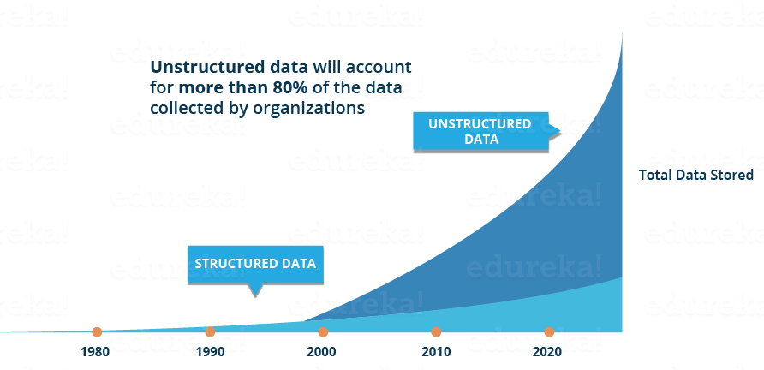
Big Data Overview : Data Structures
Big data can come in multiple forms, including structured and non-structured data such as financial data, text files, multimedia files, and genetic mappings.
Contrary to much of the traditional data analysis performed by organizations, most of the Big Data is unstructured or semi-structured in nature, which requires different techniques and tools to process and analyze.
Distributed computing environments and massively parallel processing (MPP) architectures that enable parallelized data ingest and analysis are the preferred approach to process such complex data.
four types of data structures, with 80-90% of future data growth coming from unstructured
data types.

Slide 18
Big Data Overview : Data Structures
RDBMS
XML
Web Click Stream
Image, Video, Unformatted Text

Slide 19
Big Data Overview : Data Structures
Structured data: Data containing a defined data type, format, and structure (that is, transaction data, online analytical processing [OLAP] data cubes, traditional RDBMS, CSV files, and even simple spreadsheets).
Notes:
OLAP is an acronym for Online Analytical Processing. OLAP performs multidimensional analysis of business data and provides the capability for complex calculations, trend analysis, and sophisticated data modeling. It is the foundation for many kinds of business applications for Business Performance Management, Planning, Budgeting, Forecasting, Financial Reporting, Analysis, Simulation Models, Knowledge Discovery, and Data Warehouse Reporting. OLAP enables end-users to perform ad hoc analysis of data in multiple dimensions, thereby providing the insight and understanding they need for better decision making.
An OLAP cube is a multidimensional database that is optimized for data warehouse and online analytical processing (OLAP) applications.

Slide 20
Big Data Overview : Data Structures
Semi-structured data: Textual data files with a discernible pattern that enables parsing (such as Extensible Markup Language [XML] data files that are self-describing and defined by an XML schema).
<l.:.::k =e:•"se;·:es!':eee" 1':=-et•"/ R. /a;;e;;t c;s/ ccv.rrp""' / jo;n:e· ~ ze: c':." >
<l.:.::k =~:• " St.i':es!:eet. " !-:.=-et•" / B1/a.s:t::;st c,;u/ 1ooorrapo g c / rra ·-. . C!!!! '">
<l.:.::Jc :-el"""!!t.)-'les!'l.eec" l':=e~•" / 5~ /a.:.;ets/ c .,,/ corr:rtgjJ/ .. c!lcO""'. ve:-,.cade:- c:~s " >
<l.:.::.k =e:• " st.:,·:esl':ee:t." !':.:et• " 15· / a;;ee,t c:z:Jisgrur:c ... / -e:;n;o;gs· ve:-tco;c• c='a">

Slide 21
Big Data Overview : Data Structures
Quasi-structured data: Textual data with erratic data formats that can be formatted with effort, tools, and time (for instance, web clickstream data that may contain consistencies in data values and formats).

Slide 22
Big Data Overview : Data Structures
Unstructured data: Data that has no inherent structure, which may include text documents, PDFs, images, and video.

Slide 23
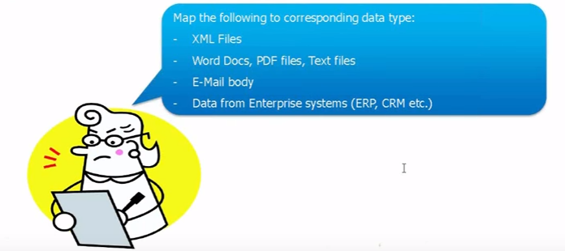
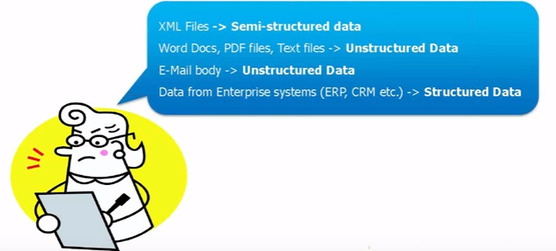
Quiz

Slide 24
Big Data Overview : Analyst Perspective on Data Repositories
Spreadsheet Analysis
Rows and columns in spreadsheets
Database administrator training is not required
set up to do many things quickly and independently of information technology (IT) groups.
Can be shared with different users
Users can have control over the logic of analysis
Variety of analysis results can be obtained.
Version control problem.
if a laptop is lost or a file becomes corrupted, the data and logic within the spreadsheet could be lost.
With the proliferation of data islands, the need to centralize the data is more pressing than ever.

Slide 25
Big Data Overview : Analyst Perspective on Data Repositories
Enterprise Data Warehouses (EDW) Analysis
Growth of data give rise to scalable data warehousing solutions.
Data to be managed centrally, providing benefits of security, failover, and a single reliable.
OLAP cubes and BI analytical tools, which provided quick access to a set of dimensions within an RDBMS.
More advanced features enabled performance of in-depth analytical techniques such as regressions and neural networks.
EDWs are critical for reporting and BI tasks and solve many of the problems that proliferating spreadsheets introduce, such as which of multiple versions of a spreadsheet is correct.
EDWs-and a good BI strategy-provide direct data feeds from sources that are centrally managed, backed up, and secured.
Restrict the flexibility needed to perform robust or exploratory data analysis.
Notes:
Business Intelligence (BI) refers to technologies, applications and practices for the collection, integration, analysis, and presentation of business information. The purpose of Business Intelligence is to support better business decision making.

Slide 26
Big Data Overview : Analyst Perspective on Data Repositories
EDW Analysis (Contd.)
Data is managed and controlled by IT groups and database administrators (DBAs), and data analysts must depend on IT for access and changes to the data schemas. This imposes longer lead times for analysts to get data most of the time is spent waiting for approvals rather than starting meaningful work.
EDW rules restrict analysts from building datasets.
EDW and BI solve problems related to data accuracy and availability. However, EDW and BI introduce new problems related to flexibility and agility, which were less pronounced when dealing with spreadsheets.

Slide 27
Big Data Overview : Analyst Perspective on Data Repositories
Analytic Sandbox
Attempts to resolve the conflict for analysts and data scientists with EDW and more formally managed corporate data.
Purposefully designed to enable robust analytics, while being centrally managed and secured.
Referred to as workspaces, are designed to enable teams to explore many datasets in a controlled fashion and are not typically used for enterprise level financial reporting and sales dashboards.
Analytic sandboxes enable high-performance computing using in-database processing

Slide 28
Big Data Overview : Analyst Perspective on Data Repositories
Analytic Sandbox(Contd.)
performance of the analysis will be better if the analytics are run in the database itself, rather than bringing the data to an analytical tool that resides
In-database processing for deep analytics enables faster turnaround time for developing and executing new analytic models, while reducing, though not eliminating, the cost associated with data stored in local, "shadow" file systems

Slide 29
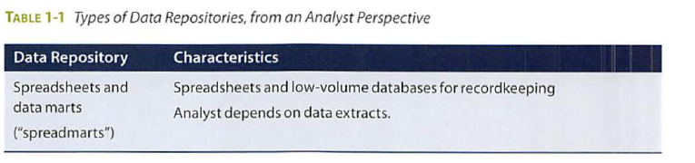
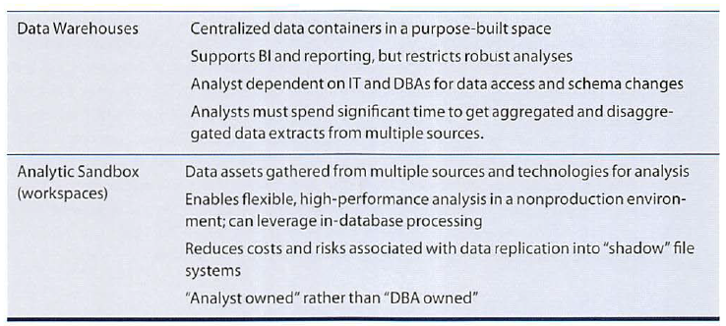

Slide 30
BI Versus Data Science
Bl tends to provide reports, dashboards, and queries on business questions for the current period or in the past.
Bl systems make it easy to answer questions related to quarter-to-date revenue, progress toward quarterly targets, and understand how much of a given product was sold in a prior quarter or year.
These questions tend to be closed-ended and explain current or past behavior, typically by aggregating historical data and grouping it in some way.
BI provides hindsight and some insight and generally answers questions related to "when" and "where" events occurred.

Slide 31
BI Versus Data Science
Data Science tends to use disaggregated data in a more forward-looking, exploratory way, focusing on analyzing the present and enabling informed decisions about the future.
Rather than aggregating historical data to look at how many of a given product sold in the previous quarter, a team may employ Data Science techniques such as time series analysis.
In addition, Data Science tends to be more exploratory in nature and may use scenario optimization to deal with more open-ended questions.
This approach provides insight into current activity and foresight into future events, while generally focusing on questions related to "how" and "why" events occur.

Slide 32
BI Versus Data Science
Where BI problems tend to require highly structured data organized in rows and columns for accurate reporting, Data Science projects tend to use many types of data sources, including large or unconventional datasets.
Depending on an organization's goals, it may choose to embark on a BI project if it is doing reporting, creating dashboards, or performing simple visualizations, or it may choose Data Science projects if it needs to do a more sophisticated analysis with disaggregated or varied datasets.

Slide 33
Lecture 4
challenges, Big Data Processing Architectures: Data Warehouse, Re-Engineering the Data Warehouse,
shared everything and shared nothing architecture, Big data learning approaches.
Data Science – The Big Picture: Relation between AI, Statistical Learning, Machine Learning , Data Mining and Big Data Analytics

Slide 34
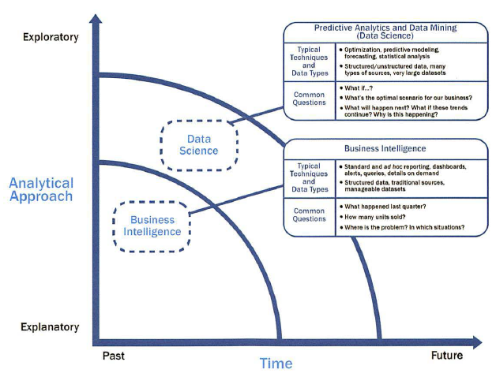
Comparison between BI and Data Science

Slide 35
Data processing revisited
Data processing can be defined as the collection, processing, and management of data resulting in information generation to end consumers.
Data Processing Cycle : Collect , Process Manage Generate
Collect : Capturing transaction data Collection of data from subsystems Data collection on forms and portals
Process: Classify Transform Sort / Merge Calculations Summarize
Manage : Storage Retrieval Archival Governance
Generate : Advanced Compute Format Present

Slide 36
Data processing techniques
Centralized processing: In this architecture all the data is collected to a single centralized storage area and processed upon completion by a single computer with often very large architectures in terms of memory, processor, and storage. ● Centralized processing architectures evolved with transaction processing and are well suited for small organizations with one location of service. ● Centralized processing requires minimal resources both from people and system perspectives. ● Centralized processing is very successful when the collection and consumption of data occurs at the same location

Slide 37
Distributed Processing
In this architecture data and its processing are distributed across geographies or data centers
Client–server. In this architecture the client does all the data collection and presentation, while the server does the processing and management of data ● Three-tier architecture. To increase processing efficiency and reduce redundancy while increasing reusability, client–server architecture evolved into three-tier systems, where the client’s processing logic was moved to a middle tier of services, thereby freeing the client from having to be tethered to the server.
N-Tier architecture.Peer –Peer architecture, Cluster architecture

Slide 38
Advantages of distributed atchitectures
Distributed processing has a lot of advantages and disadvantages. ● Advantages: – Scalability of systems and resources can be achieved based on isolated needs. – Processing and management of information can be architected based on desired unit of operation. – Parallel processing of data reducing time latencies. ● Disadvantages: – Data redundancy – Process redundancy – Resource overhead – Volumes

Slide 39
Data Processing Infrastructure Challenges
Storage : The first problem to manifest itself has been storage. With an increase in the volume of data, the amount of storage needed to process and store it increases by 1.5 times.
Transportation: the data world is moving data between different systems and then storing it or loading it into memory for manipulation.
Processing : CPU,Memory,Software
Speed or throughput : Speed is a combina- tion of various architecture layers: hardware, software, networking, and storage.

Slide 40
Shared-everything and shared-nothing architectures
Two Popular Data processing architectures
Application software such as CRM, ERP, SCM, and transaction processing require software that can drive performance. Web applications require an architecture that is scalable and flexible. Data warehousing requires an infrastructure platform that is robust and scalable.

Slide 41
Shared-everything architecture
hared-everything architecture refers to system architecture where all resources are shared including storage, memory, and the processer
The biggest disadvantage of this architecture is the limited scalability.
Two variations of shared-everything architecture are symmetric multiprocessing (SMP) and distributed shared memory (DSM).

Slide 42
Current Analytical Architecture
Data Science projects need workspaces that are purpose-built for experimenting with data, with flexible and agile data architectures.
Most organizations still have data warehouses that provide excellent support for traditional reporting and simple data analysis activities but unfortunately have a more difficult time supporting more robust analyses.

Slide 43
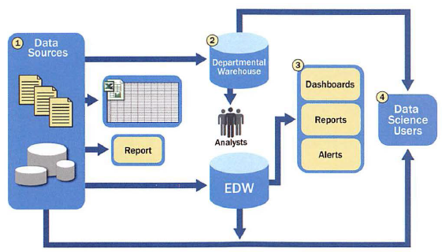
Typical Analytic Architecture

Slide 44
Analytic Architecture
Step 1.
For data sources to be loaded into the data warehouse, data needs to be well understood, structured, and normalized with the appropriate data type definitions.
Although this kind of centralization enables security, backup, and failover of highly critical data, it also means that data typically must go through significant preprocessing and checkpoints before it can enter this sort of controlled environment, which does not lend itself to data exploration and iterative analytics.
Step 2.
As a result of this level of control on the EDW, additional local systems may emerge in the form of departmental warehouses and local data marts that business users create to accommodate their need for flexible analysis.
These local data marts may not have the same constraints for security and structure as the main EDW and allow users to do some level of more in-depth analysis.
However, these one-off systems reside in isolation, often are not synchronized or integrated with other data stores, and may not be backed up.

Slide 45
Analytic Architecture
Step 3.
Once in the data warehouse, data is read by additional applications across the enterprise for Bl and reporting purposes.
These are high-priority operational processes getting critical data feeds from the data warehouses and repositories.
Step 4.
At the end of this workflow, analysts get data provisioned for their downstream analytics.
Because users generally are not allowed to run custom or intensive analytics on production databases, analysts create data extracts from the EDW to analyze data offline in R or other local analytical tools.
Many times these tools are limited to in-memory analytics on desktops analyzing samples of data, rather than the entire population of a dataset.
Because these analyses are based on data extracts, they reside in a separate location, and the results of the analysis-and any insights on the quality of the data or anomalies-rarely are fed back into the main data repository.
The typical data architectures just described are designed for storing and processing mission-critical data, supporting enterprise applications, and enabling corporate reporting activities.
Although reports and dashboards are still important for organizations, most traditional data architectures inhibit data exploration and more sophisticated analysis.

Slide 46
Traditional Data Architecture Implications for Data Scientists
High-value data is hard to reach and leverage, and predictive analytics and data mining activities are last in line for data. Because the EDWs are designed for central data management and reporting, those wanting data for analysis are generally prioritized after operational processes.
Data moves in batches from EDW to local analytical tools. This workflow means that data scientists are limited to performing in-memory analytics (such as with R, SAS, SPSS, or Excel), which will restrict the size of the data sets they can use. As such, analysis may be subject to constraints of sampling, which can skew model accuracy.
Data Science projects will remain isolated and ad hoc, rather than centrally managed. The implication of this isolation is that the organization can never harness the power of advanced analytics in a scalable way, and Data Science projects will exist as nonstandard initiatives, which are frequently not aligned with corporate business goals or strategy.
All these symptoms of the traditional data architecture result in a slow "time-to-insight" and lower business impact than could be achieved if the data were more readily accessible and supported by an environment that promoted advanced analytics.
one solution to this problem is to introduce analytic sandboxes to enable data scientists to perform advanced analytics in a controlled and sanctioned way.

Slide 47
Drivers of Big Data
The data now comes from multiple sources, such as these:
Medical information, such as genomic sequencing and diagnostic imaging
Photos and video footage uploaded to the World Wide Web
Video surveillance, such as the thousands of video cameras spread across a city
Mobile devices, which provide geospatiallocation data of the users, as well as metadata about text messages, phone calls, and application usage on smart phones
Smart devices, which provide sensor-based collec tion of information from smart electric grids, smart buildings, and many other public and industry infrastructures
Nontraditional IT devices, including the use of radio-frequency identification (RFID) readers, GPS navigation systems, and seismic processing

Slide 48
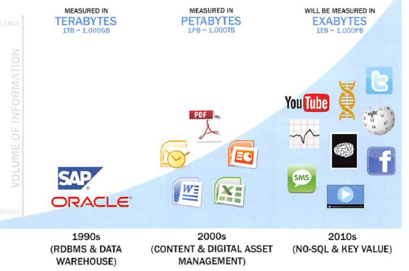
Data evolution and the rise of Big Data sources
1 Zettabyte = 1000EB
2015s
The Big Data trend is generating an enormous amount of information from many new sources.
This data deluge requires advanced analytics and new market players to take advantage of these opportunities and new market dynamics

Slide 49
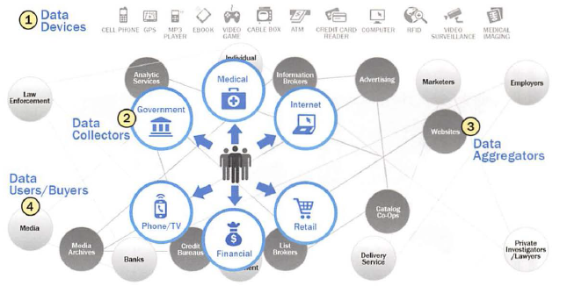
Emerging Big Data Ecosystem and a New Approach to Analytics
Notes:
Amazon Mechanical Turk - established in 2005, a de-facto standard of crowdsourcing marketplace in computer science

Slide 50
Organizations and data collectors are realizing that the data they can gather from individuals contains essential value and, as a result, a new economy is emerging.
As this new digital economy continues to evolve, the market sees the introduction of data vendors and data cleaners that use crowdsourcing (such as Mechanical Turk and GalaxyZoo) to test the outcomes of machine learning techniques.
Other vendors offer added value by repackaging open source tools in a simpler way and bringing the tools to market.
Vendors such as Cloudera, Hortonworks, and Pivotal have provided this value-add for the open source framework Hadoop.

Slide 51
Players within this interconnected web
The new ecosystem takes shape, there are four main groups of players within this interconnected web.
Data devices
Data collectors
Data aggregators
Data users and buyers

Slide 52
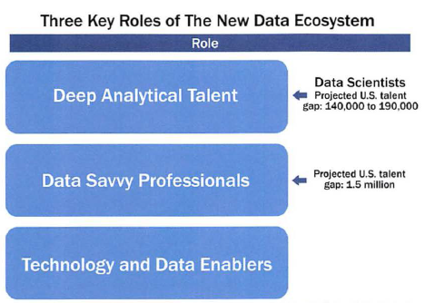
Key Roles for the New Big Data Ecosystem
The context of the Big Data ecosystem , new players have emerged to curate, store, produce, clean, and transact data.
In addition, the need for applying more advanced analytical techniques to increasingly complex business problems has driven the emergence of new roles, new technology platforms, and new analytical methods.
Is technically savvy, with strong analytical skills.
Members possess a combination of skills to handle raw, unstructured data and to apply complex analytical techniques at massive scales.
This group has advanced training in quantitative disciplines, such as mathematics, statistics, and machine learning.
To do their jobs, members need access to a robust analytic sandbox or workspace where they can perform large-scale analytical data experiments.
Examples of current professions fitting into this group include statisticians, economists, mathematicians, and the new role of the Data Scientist.
Less technical depth but has a basic knowledge of statistics or machine learning and can define key questions that can be answered using advanced analytics.
These people tend to have a base knowledge of working with data, or an appreciation for some of the work being performed by data scientists and others with deep analytical talent.
Examples of data savvy professionals include financial analysts, market research analysts, life scientists, operations managers, and business and functional managers.
This group represents people providing technical expertise to support analytical projects, such as provisioning and administrating analytical sandboxes, and managing large-scale data architectures that enable widespread analytics within companies and other organizations.
This role requires skills related to computer engineering, programming, and database administration.
Key roles of the new Big Data ecosystem

Slide 53
Three recurring sets of activities that data scientists perform:
Reframe business challenges as analytics challenges. Specifically, this is a skill to diagnose business problems, consider the core of a given problem, and determine which kinds of candidate analytical methods can be applied to solve it.
Design, implement, and deploy statistical models and data mining techniques on Big Data. This set of activities is mainly what people think about when they consider the role of the Data Scientist namely, applying complex or advanced analytical methods to a variety of business problems using data.
Develop insights that lead to actionable recommendations. It is critical to note that applying advanced methods to data problems does not necessarily drive new business value. Instead, it is important to learn how to draw insights out of the data and communicate them effectively.

Slide 54
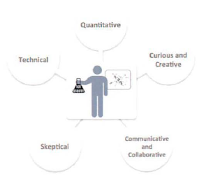
Data Scientists skills and behavioral characteristics
Quantitative skill: such as mathematics or statistics
Technical aptitude: namely, software engineering, machine learning, and programming skills
Skeptical mind-set and critical thinking: It is important that data scientists can examine their work critically rather than in a one-sided way.
Curious and creative: Data scientists are passionate about data and finding creative ways to solve problems and portray information.
Communicative and collaborative: Data scientists must be able to articulate the business value in a clear way and collaboratively work with other groups, including project sponsors and key stakeholders.
Data scientists are generally comfortable using this blend of skills to acquire, manage, analyze, and visualize data and tell compelling stories about it.

Slide 55
Questions
1. What are the three characteristics of Big Data, and what are the main considerations in processing Big Data?
2 . What is an analytic sandbox, and why is it important?
3. Explain the differences between Bl and Data Science.
4. Describe the challenges of the current analytical architecture for data scientists.
5. What are the key skill sets and behavioral characteristics of a data scientist?

Slide 56
Big Data Processing Architectures

Slide 57
Data Processing Cycles

Slide 58
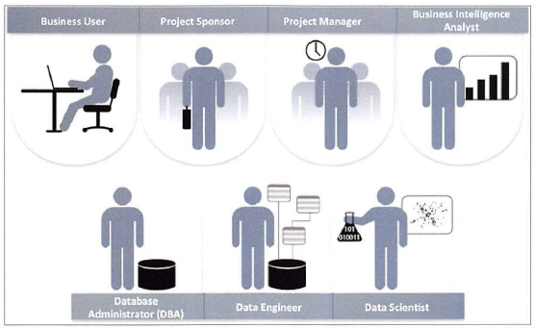
Key Roles for a Successful Analytics Project
• Project Sponsor: Responsible for the genesis of the project. Provides the impetus and equirements
for the project and defines the core business problem. Generally provides the funding and gauges the degree of value from the final outputs of the working team. This person sets the priorities for the project and clarifies the desired outputs.
• Data Engineer: Leverages deep technical skills to assist with tuning SQL queries for data management and data extraction, and provides support for data ingestion into the analytic sandbox, which Whereas the DBA sets up and configures the databases to be used, the data engineer executes the actual data extractions and performs substantial data manipulation to facilitate the analytics. The data engineer works closely with the data scientist to help shape data in the right ways for analyses.
Business User: Someone who understands the domain area and usually benefits from the results.
This person can consult and advise the project team on the context of the project, the value of the
results, and how the outputs will be operationalized. Usually a business analyst, line manager, or
deep subject matter expert in the project domain fulfills this role.
• Project Manager: Ensures that key milestones and objectives are met on time and at the expected
quality.
• Business Intelligence Analyst : Provides business domain expertise based on a deep understanding
of the data, key performance indicators (KPIs), key metrics, and business intelligence from a reporting perspective. Business Intelligence Analysts generally create dashboards and reports and have knowledge of the data feeds and sources.
• Data Scientist: Provides subject matter expertise for analytical techniques, data modeling, and
applying valid analytical techniques to given business problems. Ensures overall analytics objectives
are met. Designs and executes analytical methods and approaches with the data available to the
project.
• Database Administrator (DBA): Provisions and configures the database environment to support
the analytics needs of the working team. These responsibilities may include providing access to
key databases or tables and ensuring the appropriate security levels are in place related to the data
repositories.

Slide 59
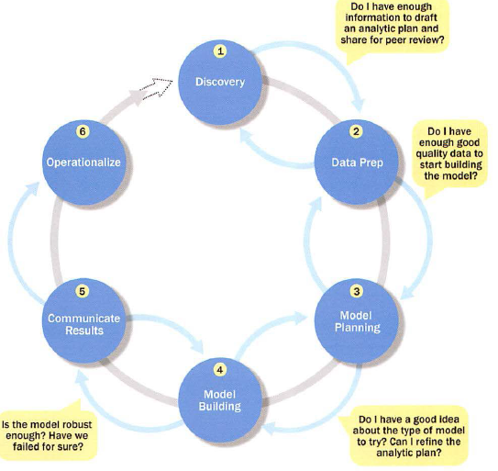
Data Analytics Lifecycle-six phases

Slide 60
Phase 1- Discovery:
In Phase 1, the team learns the business domain, including relevant history such as whether the organization or business unit has attempted similar projects in the past from which they can learn.
The team assesses the resources available to support the project in terms of people, technology, time, and data.
Important activities in this phase include framing the business problem as an analytics challenge that can be addressed in subsequent phases and formulating initial hypotheses (IHs) to test and begin learning the data.
Phase 2- Data Preparation:
Phase 2 requires the presence of an analytic sandbox, in which the team can work with data and perform analytics for the duration of the project.
The team needs to execute extract, load, and transform (ELT) or extract, transform and load (ETL) to get data into the sandbox.
The ELT and ETL are sometimes abbreviated as ETLT.
Data should be transformed in the ETLT process so the team can work with it and analyze it.
In this phase, the team also needs to familiarize itself with the data thoroughly and take steps to condition the data

Slide 61
Phase 3-Model planning:
Phase 3 is model planning, where the team determines the methods, techniques, and workflow it intends to follow for the subsequent model building phase.
The team explores the data to learn about the relationships between variables and subsequently selects key variables and the most suitable models.
Phase 4-Model building:
In Phase 4, the team develops data sets for testing, training, and production purposes.
In addition, in this phase the team builds and executes models based on the work done in the model planning phase.
The team also considers whether its existing tools will suffice for running the models, or if it will need a more robust environment for executing models and work flows (for example, fast hardware and parallel processing, if applicable).

Slide 62
Phase 5-Communicate results:
In Phase 5, the team, in collaboration with major stakeholders, determines if the results of the project are a success or a failure based on the criteria developed in Phase 1.
The team should identify key findings, quantify the business value, and develop a narrative to summarize and convey findings to stakeholders.
Phase 6-0perationalize:
In Phase 6, the team delivers final reports, briefings, code, and technical documents.
In addition, the team may run a pilot project to implement the models in a production environment.

Slide 63
Phase 1:Discovery
Learning the Business Domain
Resources
Framing the Problem
Identifying Key Stakeholders
Interviewing the Analytics Sponsor
Developing Initial Hypotheses
Identifying Potential Data Sources

Slide 64
Phase 2:Data Preparation
Preparing the Analytic Sandbox
Performing ETLT
Learning About the Data
Data Conditioning
Survey and Visualize
Common Tools for the Data Preparation Phase

Slide 65
Phase 3: Model Planning
Data Exploration and Variable Selection
Model Selection
Common Tools for the Model Planning Phase
Phase 4: Model Building
Common Tools for the Model Building Phase
Phase 5: Communicate Results

Slide 66
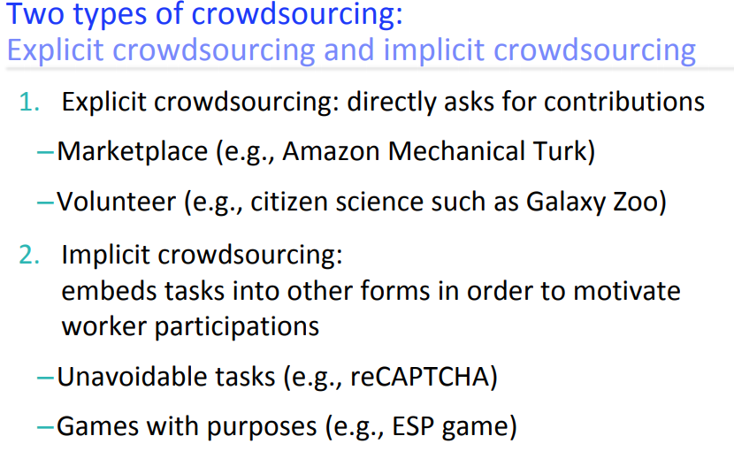
Extra

